Slide 1
Diabetic Retinopathy

Slide 2

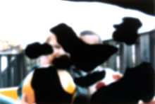
What is diabetic retinopathy (DR)?
Damage to the blood vessels in the light sensing tissue called retina
Initially, DR can cause no symptoms or only mild vision problems, but can eventually lead to complete blindness
A complication of diabetes. Type I and II both affected.
A
B

Slide 3
Who does it affect?
Up to 80% of people who had diabetes for more than 20 years have DR
Leading cause of blindness in developed countries
At least 90% of new cases could be reduced with proper treatment and monitoring of the eyes.

Slide 4
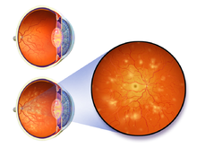
Diagnosis
Earliest stages include narrowing of retinal arteries, narrowing of blood-retinal barrier (leads to leaking of blood into retina)
Fundus photography is a common diagnosis method along with pupil dilation and optical coherence tomography

Slide 5
Stages
1. Non-proliferative DR: no symptoms, microaneurysms (blood filled bulges in artery walls), narrowed arteries (in fluorescein angiograph). Macular edema, in which blood vessels contents, is also common
2. New blood vessels form at the back of the eye because not enough blood flow happening. Not good vessels, so burst and bleed (vitreous hemorrhage)

Slide 6
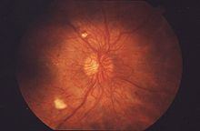
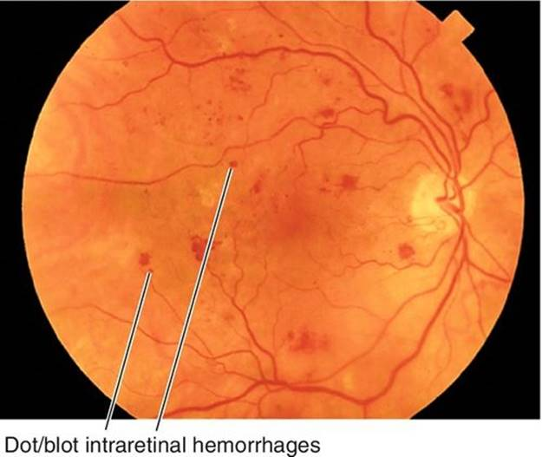
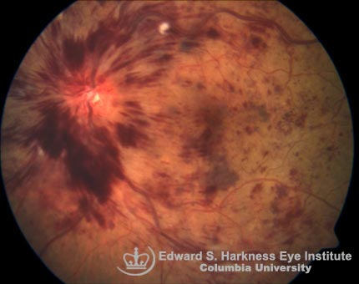
What is seen in fundus images?
Flame shaped hemorrhage (feather/ flame)
Cotton wool spots
Dot blot

Slide 7
What does a specialist look at?
Leaking blood vessels
Retinal swelling
Pale, fatty deposits on the retina
Damaged nerve tissue
Changes to retinal vasculature

Slide 8
Current technologies
IDx-DR: AI based system that autonomously scans retina images to detect early diabetic retinopathy. Approved by FDA in 2018.
Problem: based on OCT image analysis
OCT not available to everyone, but fundus photography is.
Google’s cloud based system. Not FDA approved yet.

Slide 9
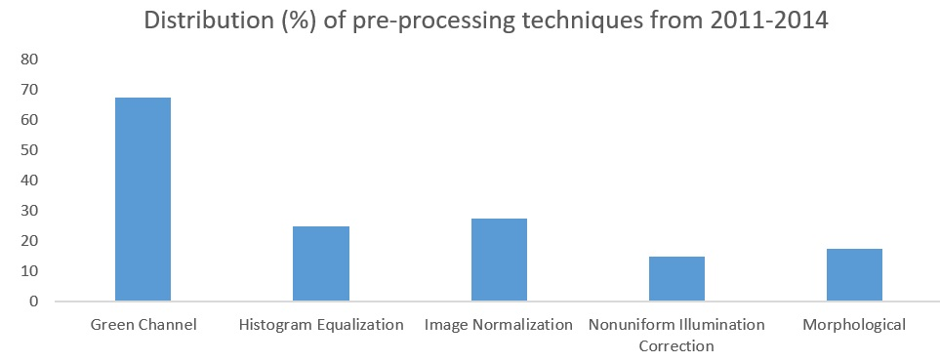
What are others looking for in fundus images?
Blood vessel information
Abnormal patters from fundus images

Slide 10
What leads to bad fundus images?
Poor images are a result of:
Cataract
Poor pupil dilation
Ptosis (falling of upper eyelid)
External ocular conditions (like conjunctivitis, inflammation of cornea)

